Slide 1
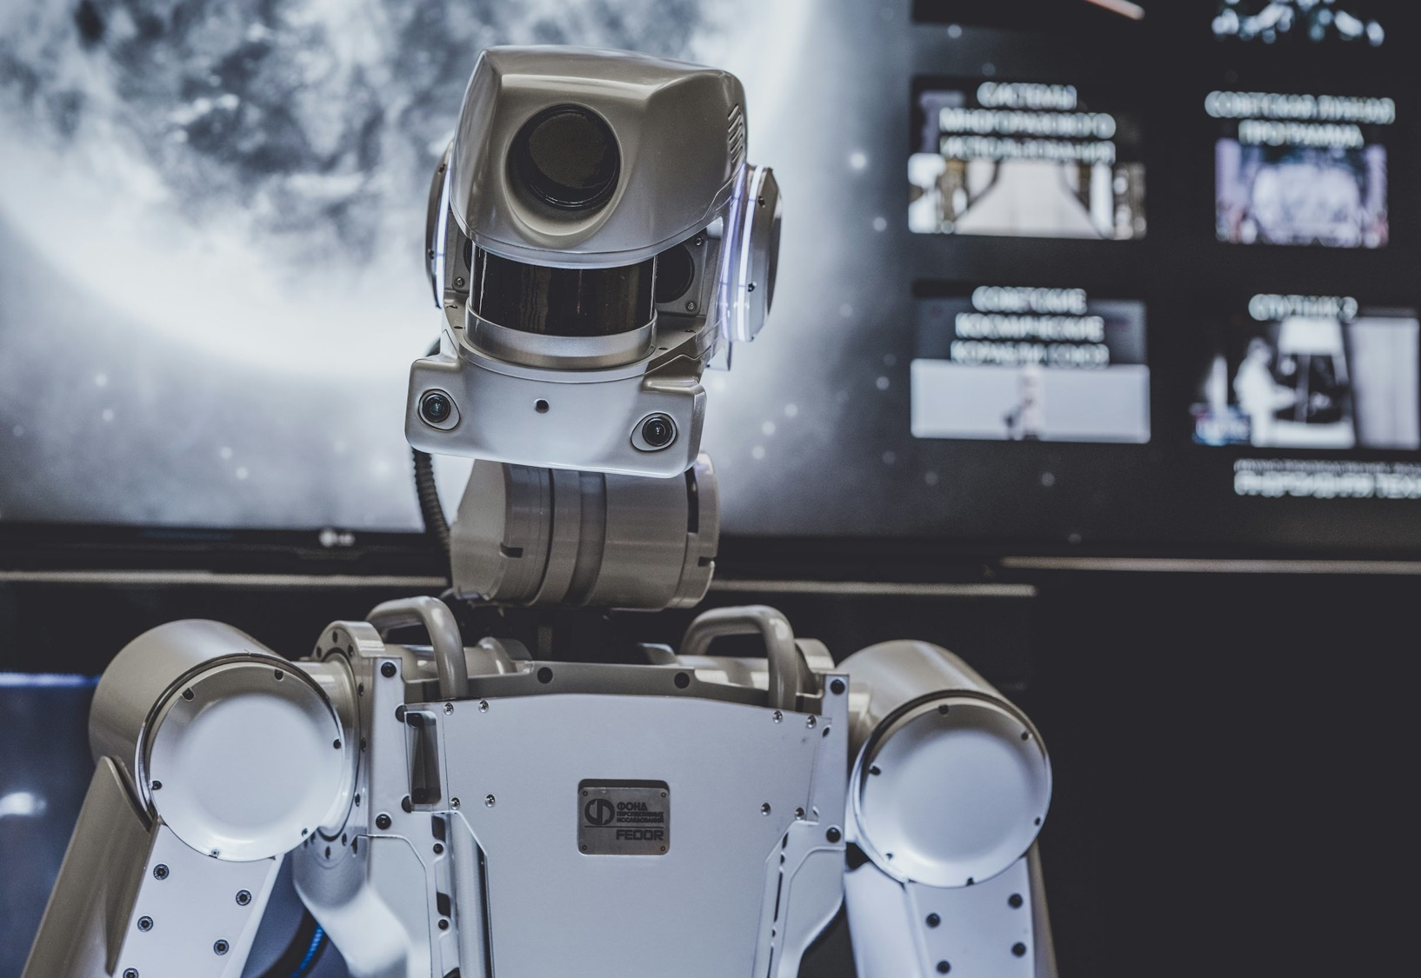

Multi Document AI
Anish Mahapatra | 2024

Slide 2

Agenda
01
Use-case analysis
02
Understanding the benefits
03
Proposed Architecture
04
MultiDocument-AI Demo
05
Improvements
06
Key Takeaways

Slide 3
Topic 1 of 6
Multi-Document Use-Case
Current State
Desired Future State
Current State
Stakeholders and Roles & Responsibilities
The management team of Australia’s Leading Digital Marketing Agency is responsible to optimize workflows and document analysis
Current Scenario
Manual workflows increases the time and cost to the company, increases the cost to company, decreases efficiency, and has human error
Expectations
The team would like to directly chat with the documents to identify critical information, based on the user’s intent. In addition, they would like to talk to any type of document, namely PDFs, Word documents, PowerPoint and excel sheets
Outcomes
The team has reduced the amount of manual effort for research and has decreased the cost to company for automated tasks by 30%**
Behaviour
Using the acquired knowledge, the team has been able to reduce the turn around time, free up man hours for more critical work and reduces the impact of human error.
Insight
The time to research and get information from a large set of documents has been decreased and automated.
Notes:
Reference Links:
**https://influencermarketinghub.com/ebooks/Artificial_Intelligence_Benchmark_Report_2023.pdf

Slide 4
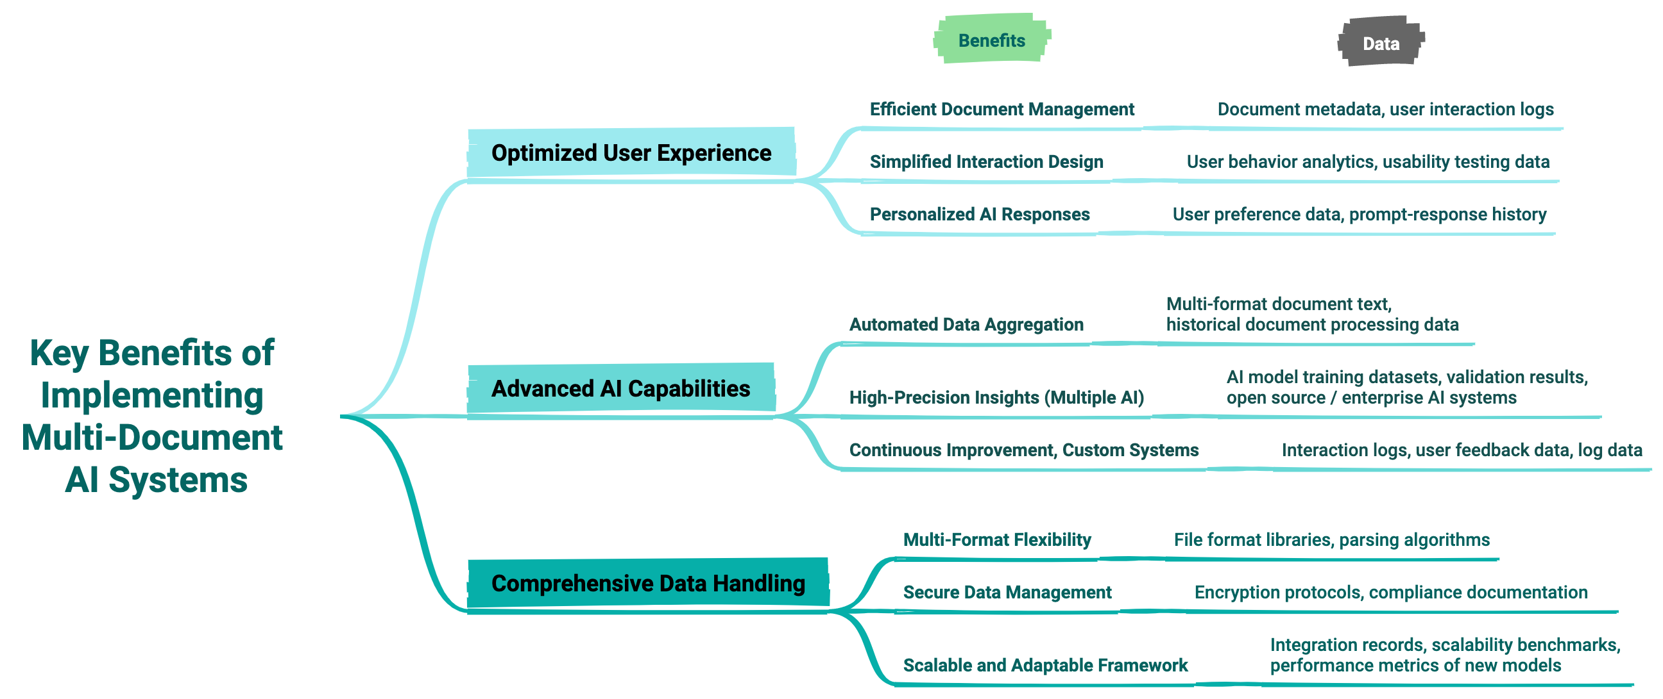



Topic 2 of 6
Representation of Hypotheses

Slide 5
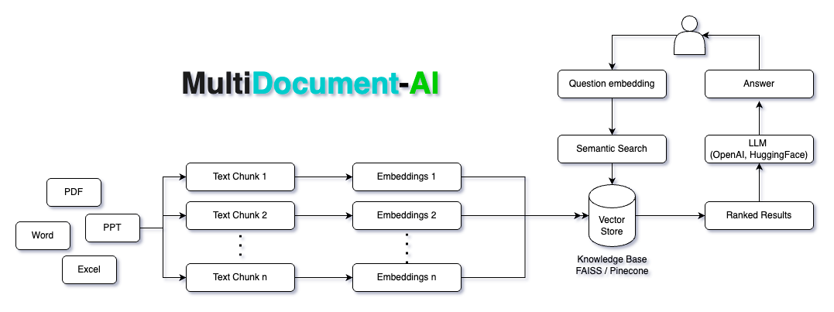
Topic 3 of 6
Current Architecture

Slide 6
















Topic 3 of 6
Scalable Architecture for MultiDocument-AI
Backend
AI Analytics
Frontend
03
Analysis
04
Daily Reports
01
02
Cloud Platform
Data Orchestration
Chat interface and real-time updates via chat interface or Power BI
05
Real-time updates
AI Analytics using Python or Spark on Databricks or Jupyter Labs
Data from multiple sources collated on a Cloud Platform
Data Orchestration and pipelines using Apache Airflow
Email alters utility to enable real-time updates for stakeholders
* The same can be replicated for any cloud platform

Slide 7

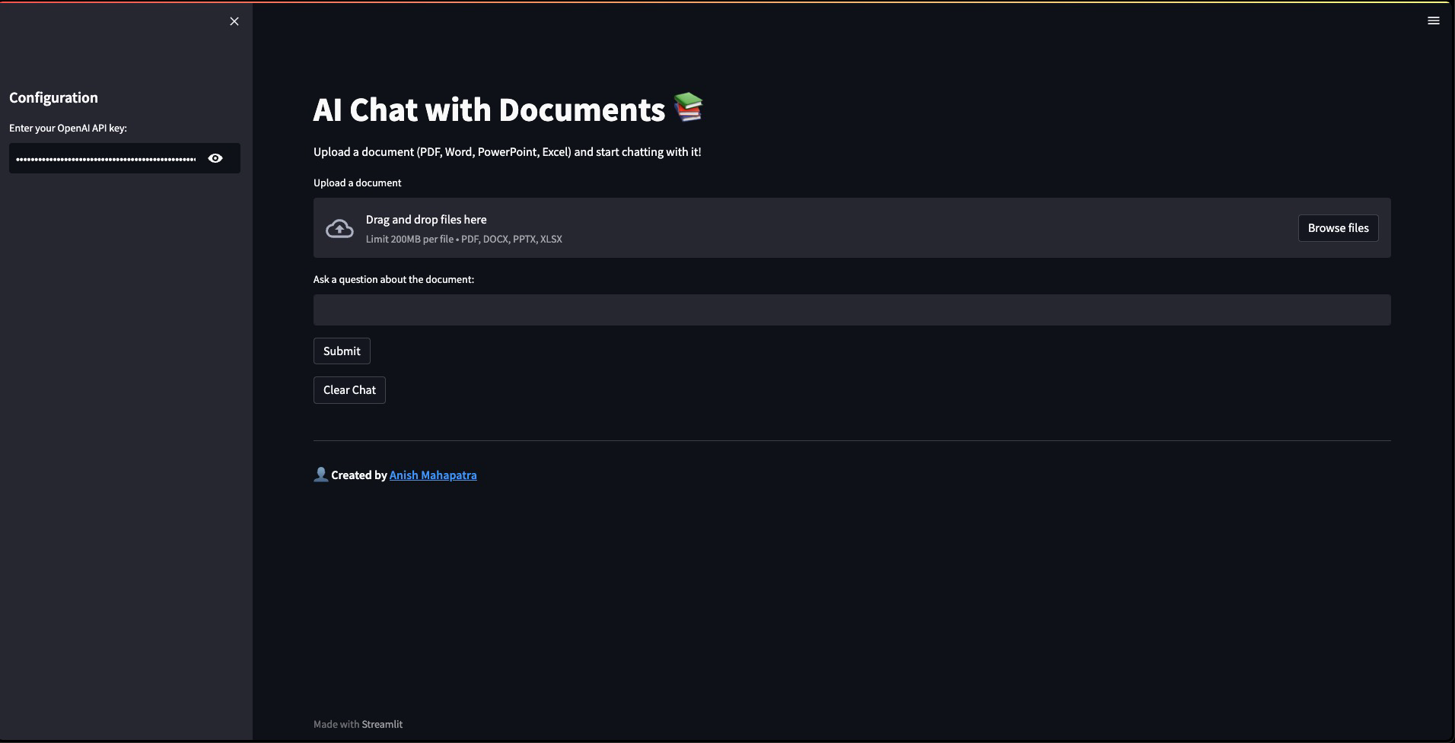

Topic 3 of 6
MultiDocument-AI Demo

Slide 8






Topic 3 of 6
Next Steps & Improvements
01
Enhanced
Security Protocols
04
Improved Data Storage Solutions
Implement AES-256 encryption and OAuth 2.0 for robust data security.
Adopt distributed cloud storage for scalable, high-speed data access.
02
05
Support for Multiple User Input and More Data Types
Cost Optimization Strategies
Utilize serverless architecture to dynamically scale resources based on usage.
Introduce real-time, concurrent session handling for multi-user collaboration and new formats of data like json.
03
06
Integration of
More Language Models
Enhanced Performance and Responsiveness
Integrate Gemini and specialized models for multilingual, multi-modal and domain-specific queries.
Optimize API calls and model inference times to reduce latency.

Slide 9







Topic 5 of 6
Additional AI Solutions for Traffic Radius
Phase I: Requirements Gathering
Phase II: AI Analytics
Phase III: Increase Bottom Line
Document
Summarization
AI-Driven
Document Insights
Automated Document
Classification
Real-Time
Document Translation
AI-Powered
Data Extraction
NLP
Search Engine
Notes:
Spend on categories
AOV
Frequency of visits
Time of visits
Demographics
Gifting?
Birthday / Anniversary
Holiday Spends
Salary Range

Slide 10
Topic 6 of 6
Key Takeaways
01
Automates document processing and analysis
02
Scalable Design
03
Simplifies document interactions with a streamlined interface
04
Reduces expenses through optimized resource use

Slide 11

Multi-Document AI
Anish Mahapatra
Discussion Session
Anish Mahapatra anishmahapatra01@gmail.com

Slide 12
Multi Document AI
Anish Mahapatra | 2024
Thank you.

Slide 13
Questions
01
What is the primary use case for this project, and who are the target users?
04
Which technology stack should we integrate this solution with to ensure compatibility and scalability?
02
How many concurrent users do we expect to support, and what are the performance requirements?
05
Would implementing real-time updates or notifications at predefined intervals enhance user engagement and efficiency?
What is the estimated budget for the current project phase, and how does it compare to the spend on existing resources performing similar tasks?
What are the key performance metrics we should track to measure the success and impact of this project?
03
06

